Slide 1
COURSE : M.SC.(CA & IT)
DIVISION : A
FACULTY NAME : MOINUDDIN QURESHI
GROUP MEMBER’S NAME : 3027 Kundan Makavana
3036 Aesha Modi
3037 Noopur Modi
3051 Kinjal Patel

Slide 2
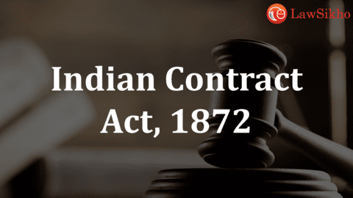

Slide 3
THE INDIAN CONTRACT ACT, 1872
The Indian Contract Act of 1872 is the most important part of business or Mercantile Law because every business or commercial transaction basically starts from an agreement between two or more persons or parties.
The Indian Contract Act, 1872 is relevant to the entire country as from September 1, 1872.
The Indian Contract Act, 1872 is the backbone of the entire bulk of Mercantile laws. Even with the development of E-commerce and introduction of Cyber-laws, the basic law of contract as contained in the Contract Act would not change. The Act is very ancient in origin and was passed in the year 1872 and is applicable to all persons-natural and artificial, i.e., Legal persons such as companies, corporations etc.

Slide 4
Important points of the Indian contract Act, 1872 :
The Indian Contract Act is based on the English Law of Contracts which is unwritten law.
In India, the law relating to contracts is contained in the Indian Contract Act of 1872 which came into force from 1st day of September 1872 and it extends to the whole of India except the State of Jammu and Kashmir.
The Indian Contract Act is not applicable only to business community alone but also to others.

Slide 5
The Indian Contract Act is not retrospective in the sense that it is not applicable to the contracts entered into before 1st September, 1872 which was the date of commencement of the Act.
The Act does not cover all those obligations which are not contractual in nature and also those agreements which are social in nature.
Section 1 to 75 of the Indian Contract Act is generally applicable to all the contracts. Section 1 of the Act makes it clear that, “Nothing herein contained shall affect the provisions of any Statue Act or Regulation not hereby expressly repealed, nor any usage or custom of trade, nor any incident of any contract, nor inconsistent with the provisions of this Act”

Slide 6

What is Contract and Contract Act?
According to Salmond, “ a contract is an agreement creating
and defining obligations between the parties.”
According to, The Indian Contract Act, 1872 defines Contract
under Section 2(h) as :
Every contract is basically an ‘agreement’ or a ‘promise’. But all agreements or all promises are not contracts. If an agreement is legally enforceable then only it is termed as a contract.
“An agreement enforceable by law is contract.”

Slide 7
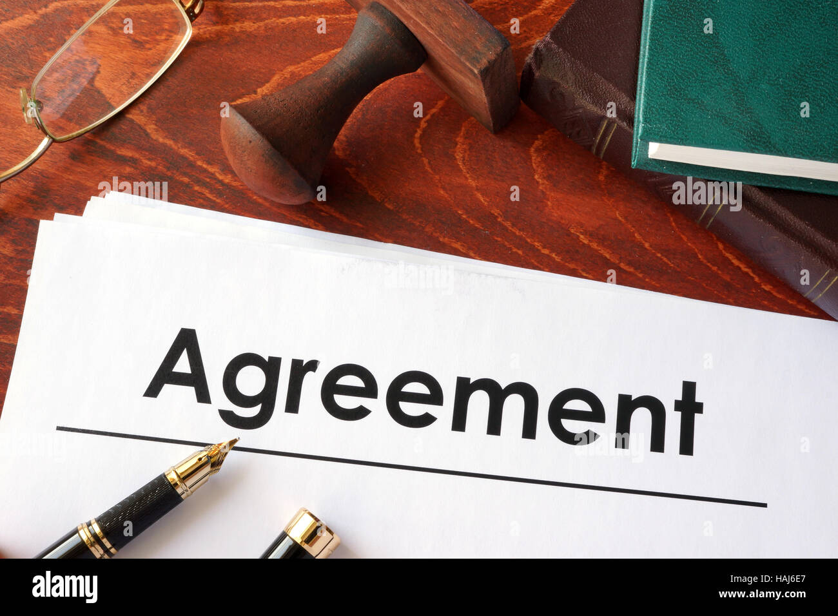
If this enforceability factor is present in an agreement it becomes a contract. Enforceability means a right to legally force the agreement on another
What is Agreement ?
Agreement is a very wide and generic term which includes
every promise, which may be legal, illegal, social, domestic,
or just a casual promise also. An agreement is a combination
of proposal and its acceptance.
Contract = Agreement + Enforceability factor
Agreement = Proposal + Acceptance

Slide 8
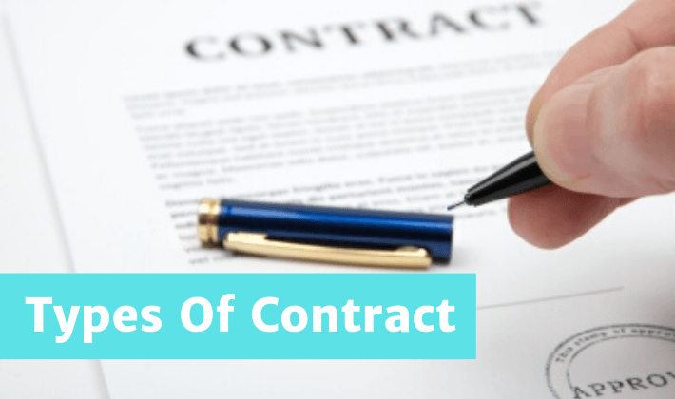

Slide 9
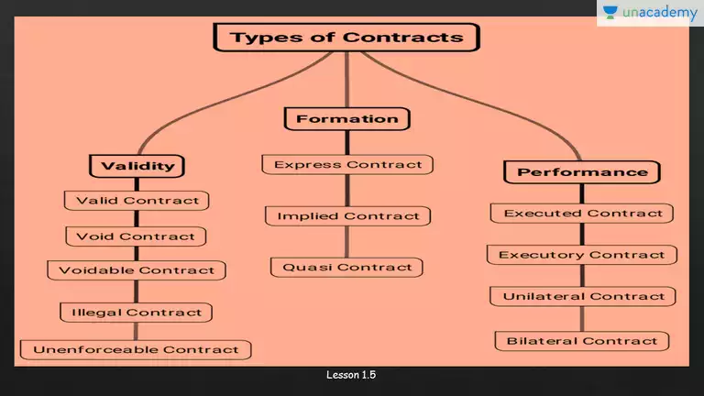

Slide 10
Based on Validity:
1.Valid Contract :- A contract that fulfill the provisions under section 10
of the indian contract , 1872 is a valid contract.
Example : A offers his house to sale for 5 lakhs rs to B . B agrees to buy it for this price. It is a valid contract.
2.Void :- An agreement which was legally enforceable When entered into but which has become void due to supervening impossibility of performance .
Example : a contract between a citizen of China and India is a valid contract during peace but if war breaks out between the two countries The agreement will become void

Slide 11
3. Voidable Contract : Thus a voidable contract is valid and enforceable until it is repudiated by the party entitled to avoid it.
Example : Ram threatens to kill Rohan if he does not agree to sell his property add to very lower price to him your essential element of free consent is absent
4. Unenforceable Contract : It is a contract which is otherwise valid, but can not be enforced because of some technical defect like absence of a proper stamp. such contract will not be enforced by the courts until and unless the defect is rectified
Example: A borrows rupees 10,000 from B and make a promissory note and a one rupees damage to be pasted on the promissory note. The agreement though complete is unenforceable because of the technical defect promissory not being understaffed

Slide 12

5. Illegal Contract : A contract is illegal if it involves
doing something that is a criminal act or civil wrong
or against the contract law.
Example : An agreement is made for robbery
Or murder it is illegal contract.

Slide 13
Based on Formation:
1.Express Contract : When Contracts are either in writing or oral.
Example :He offers to sell his house for rupees 5,00,000 to me by word of mouth and be agrees to buy it for this price by word of mouth or in writing .
2.Implied Contract : When Contracts are neither in writing nor in oral but inferred from the acts or circumstances of a particular case.
Example: the bus driver marily stops the bus at the bus stop and the passenger board without being invited

Slide 14

3.Quasi Contract : it is a contract in which there is no intention on either side to make a contract but the law imposes a contract.
Example: A Finder of lost goods is under obligation to find out the true owner and return the goods.
4.E-com Contracts : these contracts are enter into between the parties using Internet. In electronic commerce different parties or persons
create networks which are linked to other networks through
EDI (Electronic data interchange).This helps in doing
business transaction using electronic mode.
Example: Online sale purchase through websites

Slide 15
Based on Performance:
1.Execute Contract : An executed contract is one where both the parties have performed their obligations.
Example : A sells a TV set to for ₹20,000 . B pays the price and A hands over TV set to B.
2.Executory Contract: Where the contract is yet to be performed either wholly or partially or one or both the parties have yet to perform their obligations.
Example: A agrees to make furniture for B for rupees 5000 Mr. A has yet to make furniture and Mr B has not made the payment so both A & B are yet to perform their obligations. suppose A has made the furniture but B has yet to make payment it is executed on A’s part but executory on B’s part.

Slide 16
3.Unilateral Contract : In this one party do the contract has fulfilled the commitment while the other party has yet to do it.
Example: A has mad contract with B to sell goods to him on one month credit and immediately dispatches the goods. A has fulfilled his commitment while B has yet to do it.
4.Bilateral Contract : In a Contract where both the parties have performed their obligation. Bilateral & Executory are same and interchangeable.
Example : A deliver goods to B and B makes the payment immediately.

Slide 17
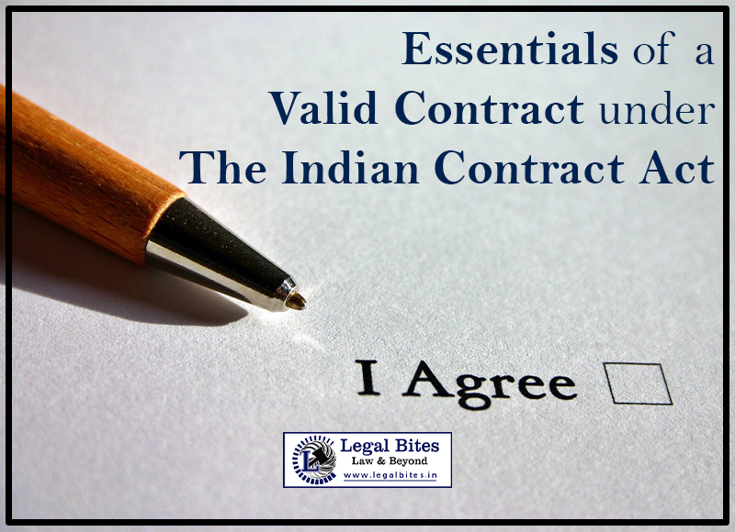
Essential elements of valid contracts
The two elements of a contract are: (1) an agreement; (2) legal obligation. Section 10 of the Act provides for some more elements which are essential in order to constitute a valid contract.
This is known as: ”All agreements are contracts if they are made by free consent of parties, competent to contract, for a lawful consideration and with a lawful object and are not hereby expressly declared to be void.”

Slide 18
Agreement : When one party brings up a proposal and the other party accepts it; is the base for every contract.
Case Study:
X invites Y to the dinner. Why accepts the invitation but fails to turn up can X sue Y for the damage?
Solution :
X cannot claim any damages from Y because the agreement between X and Y is not enforceable by law. It is a social agreement and the usual presumption in such agreement is that parties do not intend to create legal relationship.
Intention to Create Legal Obligation : The involved parties should aim at creating a legal responsibility on one another. That is on non-fulfilment of the contract; the parties can seek legal consequences.
Case Study :
X makes a promise to his wife Y to give her pocket money of rupees 1000 per month. After 6 months, he stops making the payment. Can we claim damages from X?
Solution : Y cannot claim any damages from X because the agreement between X and Y is not enforceable by law. It is a social agreement end the usual presumption in search agreement is that the parties do not intend to create legal relationship

Slide 19
Writing and Registration: The contracts can be formed orally or in writing; however, in some cases, only a written and duly registered contract is acceptable.
Case Study :
X polished Y’s shoes without being asked by Y to do so. Y does not make any attempt to stop X from polishing the shoes. Is Y bound to make any payment to X?
Solution : Y is bound to pay because he has accepted X’s implied offer by conduct.
Free Consent : The parties must mutually agree upon the contractual terms and conditions; independent of any fraud, mistakes, undue influence, coercion and misrepresentation.
Case study :
X promises Y to give a diamond ring at the time of his marriage. X fails to give the ring. Can Y claim the ring?
Solution : Y cannot claim the diamond ring because there is no consideration from Y.

Slide 20
Lawful Consideration : The parties to the contract must jointly agree upon a fair and legal compensation or price.
Case Study :
X threatens to kill Y if he (Y) does not sell his house to X for rupees 1,00,000. agre Y es. X borrows rupees 1,00,000 from Z who is also aware of the purpose of the loan. What is the nature of the agreement between X and Y and X and Z.
Solution : the contract between X and Y is voidable at the option of Y because Y’s consent is not free as it has been obtained by coercion. The contract between X and Z is a valid contract because the object of the contract is lawful.
Case Study :
X agrees to pay Y rupees 1,00,000 if Y kills Z. To pay Y, X Borrows rupees 1,00,000 from W who is also aware of the purpose of the loan. Y kills Z but X refuses to pay. X also refuses to replay the loan to W. Advice Y and W.
Solution : the agreement between X and Y is an illegal agreement because its object is unlawful. Hence, Y cannot recover anything from X. Since the main agreement between X and Y is illegal, the agreement between X and W which is collateral to the main agreement is also void and hence W cannot recover anything from X.

Slide 21
Certainty of Meaning : The meaning of a contract should be apparent, and the purpose of it should be wholly mentioned to keep it valid.
Case Study :
X agrees to Marry Y. Y dies before the marriage takes place. Is it a void agreement?
Solution it is not a void agreement. It is a void contract because it was valid when it was entered into but subsequently became void on the death of Y.
Not Expressly Declared Void: The agreements which are not otherwise considered to be unlawful (such as those made to restrict any trade practices, marriage or legal proceedings); are liable to become contracts.
Case Study :
X agrees to pay Rs. 1,00,000 to Y if Y does not marry throughout his life. Y promises not to marry at all but later on X refuses to pay Rs. 1,00,000. Advise Y.
Solution : Y cannot recover anything. The agreement between X and Y is in restraint of marriage which has been expressly declared void under section 26.

Slide 22
Performance Possibility: The terms of the contract should be lawful as well as practical enough to be executed by both the parties.
Case Study :
X agreed to sell a particular horse to Y. Later on, it was discovered that the horse was dead at the time of making the contract. Advice the parties.
Solution : the agreement is void because both the parties were under a mistake of fact regarding existence of the subject matter. It is practically not possible sell a dead horse.
Legal Object: There should be a lawful purpose or aim behind a contract.
Case study :
X agrees to let his flat to Y 4 use as a gambling den on a monthly rent of rupees 10,000. After 3 months, Y stops making the payment of rent. Advice X.
Solution: X cannot recover anything. The agreement between X & Y is void because the object of the agreement is unlawful

Slide 23
Competency: Both the parties must be capable of participating in a contract according to the court, i.e., they should be major (i.e., more than 18 years of age), mentally sound and free from any lawsuits or disqualification by law.
Case-Study : Plaintiff, Dharmodas Ghose was in need of money therefore, he pledged his property and asked for loan of Rs. 20,000 from the moneylender Brahmo Dutt. The debt amount given was less than Rs. 20,000. Brahmo Dutt who was acting as attorney at that time on the behalf of the moneylender, knew that Dharmodas Ghose was a minor. Plaintiff filed a suit against Brahmo Dutt stating that the mortgage deed should be null and void because he was a minor at the time of contract and hence, it should be cancelled. Later, Brahmo Dutt passed away and the appeal was prosecuted by his executors. And it was contended by the defendant that plaintiff should not be excused as he misrepresented his age to him. Even if the deed is void, the debt that was advanced to him i.e., Rs. 10,500 should be repaid.

Slide 24
1. Was the mortgage deed void?
2. Deed signed by defendant was voidable or not?
3.Was the defendant entitled liable to receive the mortgage money?
Solution: The Privy Council held that the; person who mortgaged the property was infant at the time of execution. So, the contract or mortgage deed which was made between the plaintiff and the defendant was not merely voidable but it was void. It also held that any contract with a minor or an infant is ‘void ab-initio’. Since minors are incompetent to contract hence, such contracts are void and invalid in the eyes of law. The minor is not obliged to pay back the amount that was advanced to him as he was not bound by the promise that was executed in contract.

Slide 25
THANK YOU !!!

